Slide 1
Android Programming
Mobile Development
Dr Ian Drumm

Slide 2
Getting Started
Aims:
Building a navigation graph
Learning Outcomes:
Fragment activities
Navigation
Sharing a model between fragments

Slide 3
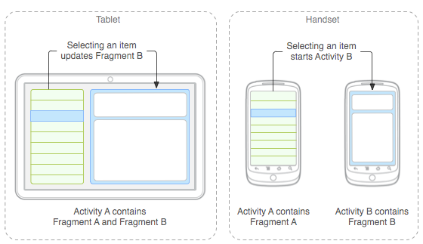
Fragment Activities
https://developer.android.com/guide/components/fragments.html
a modular section of an activity (a "sub activity")
you can combine multiple fragments in a single activity
has its own lifecycle and receives its own input events
you can add or remove while the activity is running
can reuse in different activities

Slide 4
Fragment class
public class MyFragment extends Fragment {
public View onCreateView(LayoutInflater inflater, ViewGroup container, ...)
{
return inflater.inflate(R.layout.my_fragment_xml, container, false);
}
}
Subclass Fragment
Create Layout for Fragment in XML file
The fragment creates their view hierarchy in onCreateView() with inflater

Slide 5
The <fragment> tag
Can add a fragment to main activity…
<fragment
android:id="@+id/fragment_container"
..
/>

Slide 6
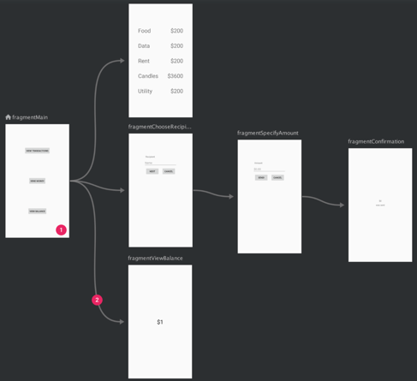
Navigation Graph
An XML resource with navigation destinations, and actions for navigating between them.

Slide 7
NavHostFragment
a widget you add to your main activity layout for displaying the destinations for the navigation graph
In activity_main.xml file
<fragment android:id="@+id/navigation_host_fragment" android:layout_width="match_parent" android:layout_height="match_parent”
android:name="androidx.navigation.fragment.NavHostFragment" app:navGraph="@navigation/my_nav_graph" app:defaultNavHost="true" />

Slide 8
NavController
an object that keeps track of the current position within the navigation graph
used for swapping destinations in the NavHostFragment as you move through a navigation graph
nc=Navigation.findNavController(view);
nc.navigate(R.id.action_firstFragment_to_secondFragment2);

Slide 9
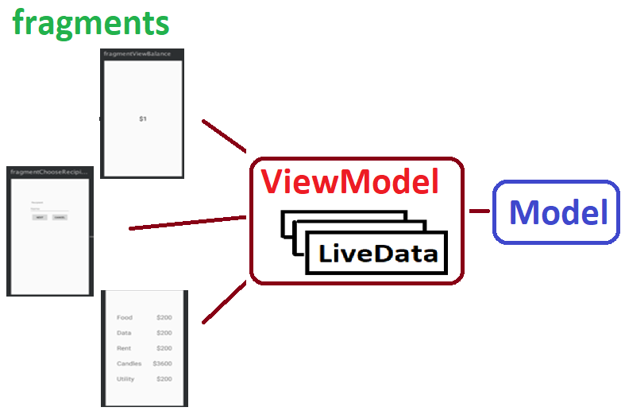
Sharing Data Between Fragments
Your data held in a model
ViewModel wraps model
LiveData lets you observe changes to model
Fragments can bind and unbind to ViewModel
ViewModel lifecycle independent of view

Slide 10
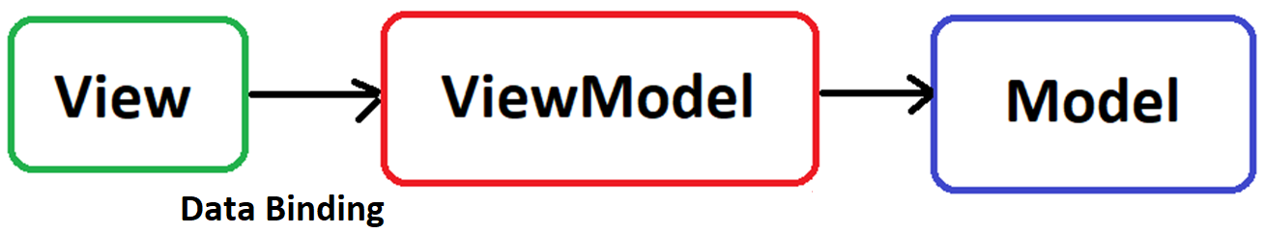
MVVM Design Pattern
View – user interface
ViewModel – holds observable data for UI
Model – holds data
Data Binding: listeners for ViewModel Properties

